Slide 1
Daily Based Rental Bike Predictor Using Classical ML Techniques (With Comparative Study)
Iman Hindi & Mais Maqableh
Applied Machine Learning Course, AI Master Program.
University of Jordan, Amman Jordan.
Jan 16,2023

Slide 2
Outlines
Introduction
Problem Definition
Objectives
Dataset Description
Dataset Exploration
Comparative Study of Models Performance
Hyper Parameters Tuning of Best Models
Enhance the Best Model Performance
A-B Testing and Results
Conclusion

Slide 3
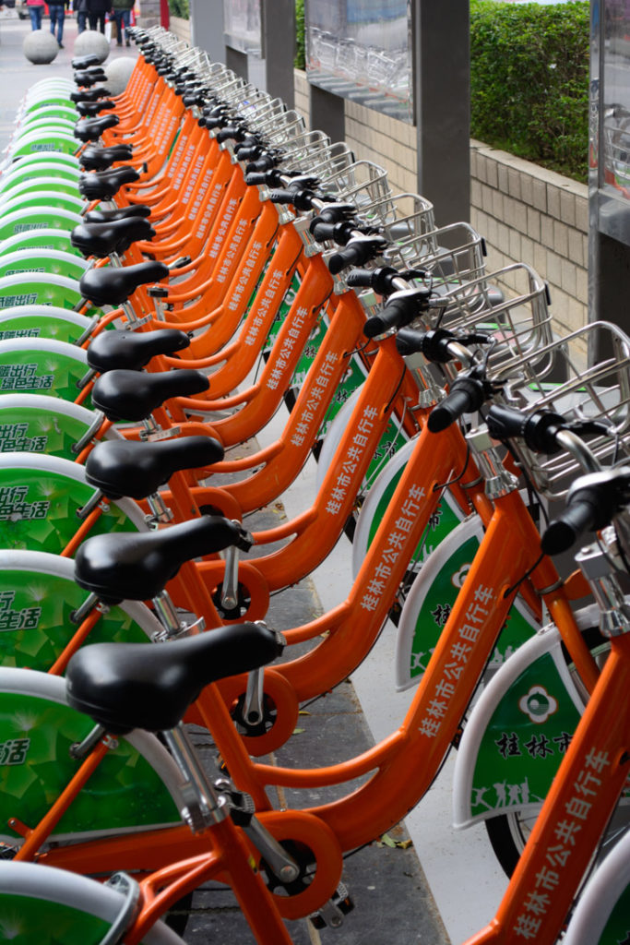
Introduction
Rental Bikes’ sharing system (RBSS): become widely used in urbans places.
RBSS Mobility comfort on individuals: Thefts, parking, storage or even maintenance.
RBSS Positive impact on communities: reduce traffic congestion, car parking, pollution, healthy transport.
The bicycle can be rented from a location and returned to another location.
Most stations become automated with a powerful system control the process and let the users easily and rapidly service themselves.
1

Slide 4
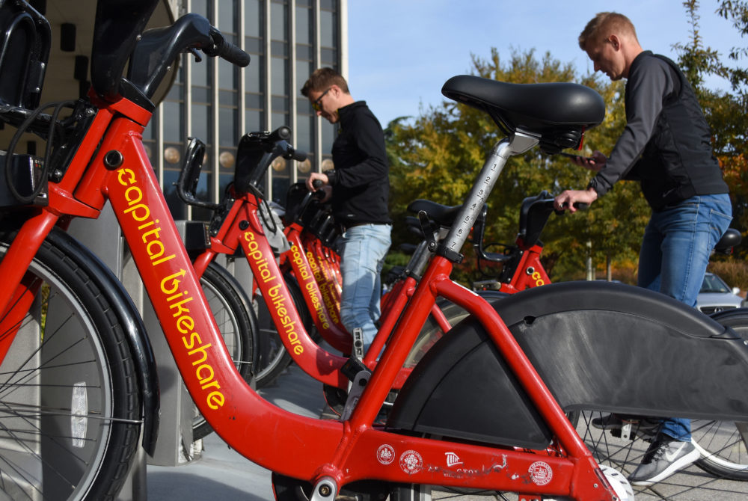
Problem Definition
Bike-sharing systems provide a discrete and limited number of bikes, whose distribution can vary throughout a city.
Supply the stations with sufficient number of bicycles make the rental bike available and accessible to the public at the right time as it lessens the waiting time.
Providing stations with a stable supply of rental bikes to cover the varied demand became a major concern.
The crucial part is that the prediction of bike count required at each day or hour for the stable supply of bikes by taking into considerations all the factors that can affected the rental bikes demand.
2
Notes:
These systems is controlled by regional programs are implemented where numerous renting locations are set.
creating a network of locations where bicycles can be borrowed from and returned.
bike-sharing systems provide a discrete and limited
number of bikes, whose distribution can vary throughout a
City.
supply the stations with sufficient number of bicycles such
that one person's usage does not encroach upon another's use of the good, and thus make the rental bike available and
accessible to the public at the right time as it lessens the
waiting time.
providing each station with a stable supply of rental bikes that can cover the varied demand became a major concern. The crucial part here is the prediction of bike count required at each day or hour for the stable supply of rental bikes by taking into considerations all the factors that can affected the rental bikes demand.

Slide 5
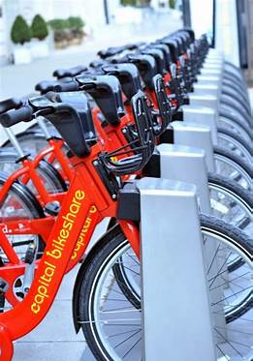
Objectives
In our case study, we focused on studying the performance of different ML algorithms on predicting the daily bike rental counts for data set of two-year daily basis historical log from Capital Bike-share system (Washington D.C., USA).
Comparing ML Algorithms performances, using different evaluation metrics.
Selecting and fine tuning the best scored model to enhance the predictions and minimizing the RMSE error.
Enhance the best model performance by applying Data Augmentation Technique.
A-B System testing to show the enhancement in the model.
3
Notes:
These systems is controlled by regional programs are implemented where numerous renting locations are set.
creating a network of locations where bicycles can be borrowed from and returned.
bike-sharing systems provide a discrete and limited
number of bikes, whose distribution can vary throughout a
City.
supply the stations with sufficient number of bicycles such
that one person's usage does not encroach upon another's use of the good, and thus make the rental bike available and
accessible to the public at the right time as it lessens the
waiting time.
providing each station with a stable supply of rental bikes that can cover the varied demand became a major concern. The crucial part here is the prediction of bike count required at each day or hour for the stable supply of rental bikes by taking into considerations all the factors that can affected the rental bikes demand.

Slide 6
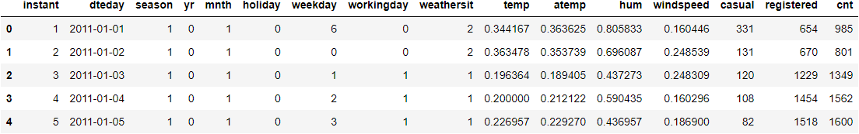
Dataset Description
Data set is taken from Kaggle [4], which consist of two-year historical log.
number of records: 731 days.
number of features: 12 features as follows:
Categorical Features Numerical Features Bikes Counts
4
Notes:
These systems is controlled by regional programs are implemented where numerous renting locations are set.
creating a network of locations where bicycles can be borrowed from and returned.
bike-sharing systems provide a discrete and limited
number of bikes, whose distribution can vary throughout a
City.
supply the stations with sufficient number of bicycles such
that one person's usage does not encroach upon another's use of the good, and thus make the rental bike available and
accessible to the public at the right time as it lessens the
waiting time.
providing each station with a stable supply of rental bikes that can cover the varied demand became a major concern. The crucial part here is the prediction of bike count required at each day or hour for the stable supply of rental bikes by taking into considerations all the factors that can affected the rental bikes demand.

Slide 7
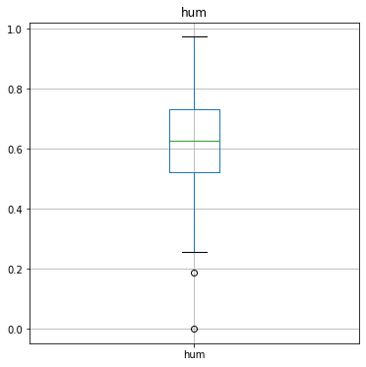
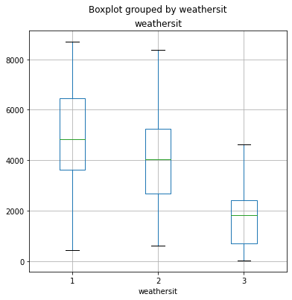
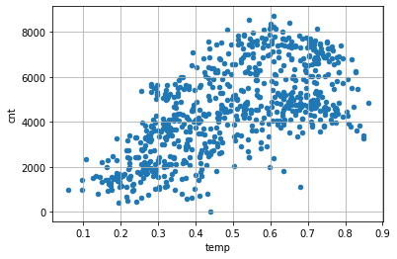
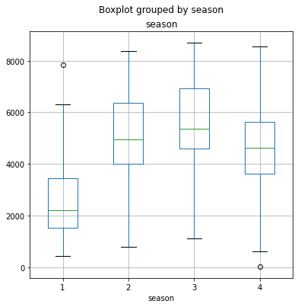
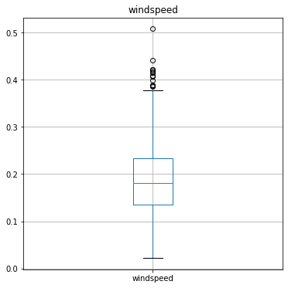
Dataset Exploration
Normalize numerical features using Standard scaler.
Extracting the day component from dteday column.
Drop Outliers in the sample values on humidity and wind speed features.
Calculate the counts of each categorical features values, shows a high imbalances in the holiday feature’s categories.
Check the relation of bikes counts with features.
5

Slide 8
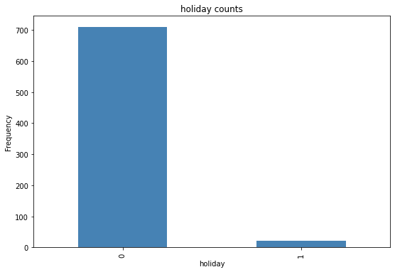
Dataset Splitting
Since the data set is imbalanced towards the holiday feature we split the data set to train and test using stratified split with respect to holiday feature to ensure that the data set is representative to all sample values, and thus lead to more accurate performance results.
6

Slide 9
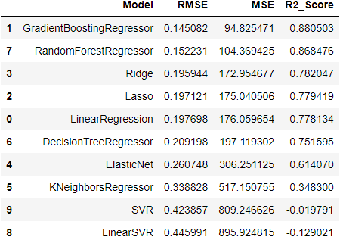
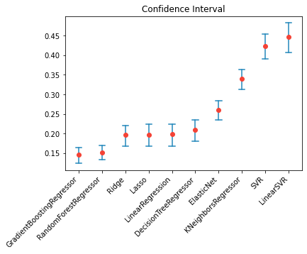
Evaluate Models’ Performance
Best R2_score and RMSE Model: GBR
Lowest RMSE confidence interval: GBR
RMSE
7

Slide 10
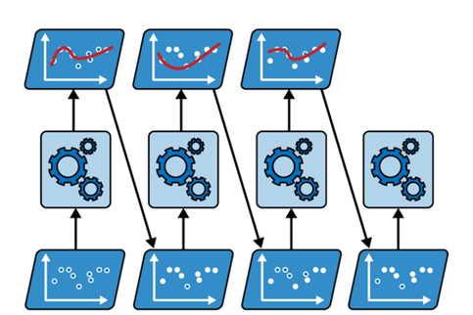
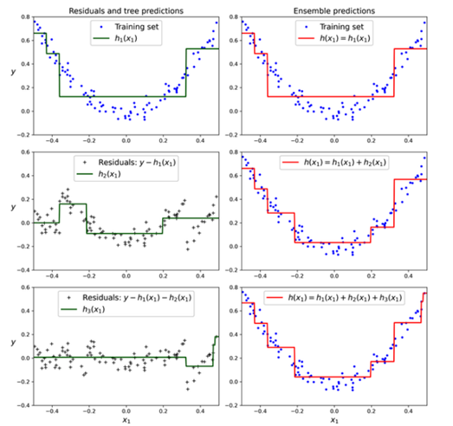
Select GBR as Best Model
Boosting Regression Ensemble Model
Adjusting Predictions by GBR
8

Slide 11
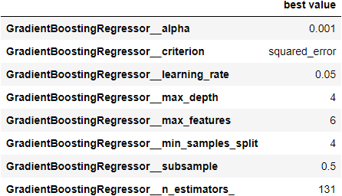
Tuning GBR Hyper Parameters
RMSE decrease to 13.4%
R2_Score increase to 90%
Sensitivity analysis & GridSearchCV are used to find the best hyper.
Adjust n_iter_no_change hyper parameter to 10 to automatically stop adding more trees during training if the last 10 estimators didn’t help.
By using n_iter_no_change, fit() method automatically splits the training set into a training and validation.
Validation_fraction hyper parameter set to 10%.
9
Notes:
GridSearchCV from Scikit learn to find the best hyper parameters to enhance the model performance.
The n_iter_no_change hyper parameter is adjust to an integer value= 10, this help the Gradient Boosting Regressor to automatically stop adding more trees during training if it sees that the last 10 estimators didn’t help. This is simply early stopping, but with a little bit of patience: it tolerates having no progress for a few iterations before it stops [5]
When n_iter_no_change is set, the fit() method automatically splits the training set into a smaller training set and a validation set: this allows it to evaluate the model’s performance each time it adds a new estimator. The size of the validation set is controlled by the validation_fraction hyper parameter, which is 10% by default. The tol hyper parameter determines the maximum performance improvement that still counts as negligible. It sets to defaults 0.0001. The Gradient Boosting Regressor class also supports a subsample hyper parameter, which specifies the fraction of training instances to be used for training each tree. If subsample=0.25, then each tree is trained on 25% of the training instances, selected randomly [5].
The best values of hyper parameters found by the GridSearchCv, which give the highest performance, are listed in the following table:

Slide 12
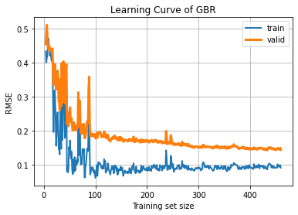
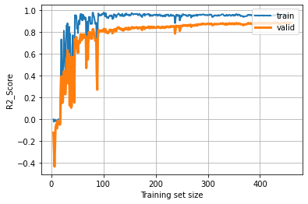
Learning Curves of GBR model
Train & Valid RMSE Learning Curve
Train & Valid R2-Score Learning Curve
10

Slide 13
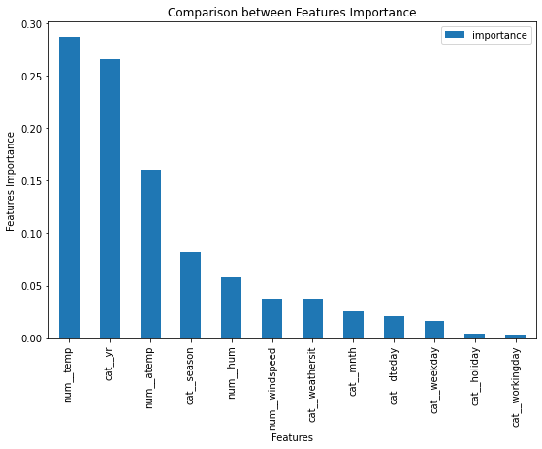
Features’ Importance
The most significant features that affect the bike counts predictions is year and temperature.
The least important is holiday and working day features.
11

Slide 14
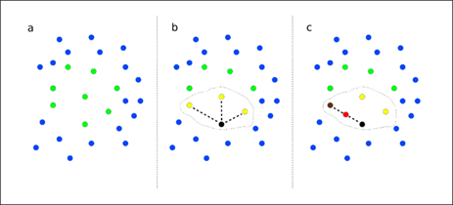
Applying Data Augmentation
Synthetic Minority Over-sampling Technique (SMOTE) for classification.
SMOTER for regression.
12

Slide 15
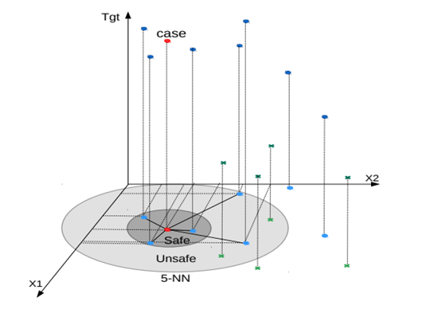
Applying Data Augmentation
SMOGN, for tackling imbalanced regression problem.
It’s a pre-processing method that has the advantage of being versatile, it allows the use of any standard learning algorithm.
The method tries to overcome difficulties in SmoteR strategy and in the introduction of Gaussian Noise strategy.
13
Notes:
SMOGN, for tackling imbalanced regression problem.
It’s a pre-processing method that has the advantage of being versatile.
Allows the use of any standard learning algorithm. The method tries to overcome difficulties in SmoteR strategy and in the introduction of Gaussian Noise strategy.
It uses the interpolation method of SmoteR for interpolating examples that are closer.
eliminate the risk of interpolating examples that, although being among the nearest neighbors of the seed example, are too distant.

Slide 16

A-B Testing and Results
The result shows enhancement in the overall performances of the model with Applying SMOGN than the model without SMOGN.
In SMOGN, the data samples become larger and balanced, so the model able to fit the data perfectly.
RMSE decrease to 7.8%
R2_Score increase to 95.4%
14

Slide 17
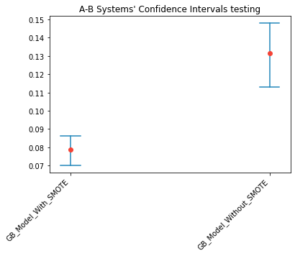
A-B Testing and Results
Confidence Coefficient is 0.95
The confidence interval is become lower and shorter which is better.
because the data samples become larger and also the model able to fit the data perfectly.
RMSE
GBR_With_SMOGN
GBR_Without_SMOGN
15
Notes:
SMOGN, for tackling imbalanced regression problem.
It’s a pre-processing method that has the advantage of being versatile.
Allows the use of any standard learning algorithm. The method tries to overcome difficulties in SmoteR strategy and in the introduction of Gaussian Noise strategy.
It uses the interpolation method of SmoteR for interpolating examples that are closer.
eliminate the risk of interpolating examples that, although being among the nearest neighbors of the seed example, are too distant.

Slide 18
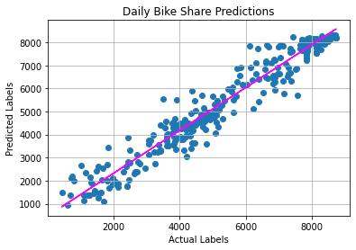
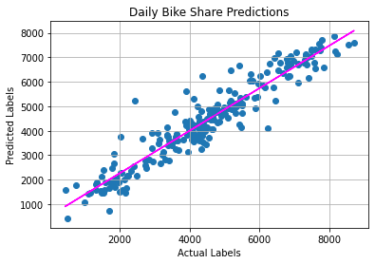
A-B Testing and Results
Predictions of GBR With SMOGN
Predictions of GBR Without SMOGN
16
Notes:
SMOGN, for tackling imbalanced regression problem.
It’s a pre-processing method that has the advantage of being versatile.
Allows the use of any standard learning algorithm. The method tries to overcome difficulties in SmoteR strategy and in the introduction of Gaussian Noise strategy.
It uses the interpolation method of SmoteR for interpolating examples that are closer.
eliminate the risk of interpolating examples that, although being among the nearest neighbors of the seed example, are too distant.

Slide 19
Conclusion
A real RBSS data concatenated with the corresponding weather data to study the performance of different ML algorithms in such a problem.
We evaluated different ML algorithms, and Gradient Boosting Regressor shows a promising result in all evaluation metrics (RMSE, MSE, R2Score, and confidence intervals).
We also studied the effect of using data augmentation technique by enlarging the data set samples by using SMOGN technique,
In addition, A_B testing used to compare both models, which shows enhancement in the prediction output with respect to the actual values.
As shown in this study, the RBSS is highly correlated to the weather conditions especially for (temperature degree and the heavy rain conditions in addition to wind speed). These factors may affect the demand on bike renting by users.
17

Slide 20
THANK YOU
Iman Hindi & Mais Maqableh
Applied Machine Learning Course, AI Master Program.
University of Jordan, Amman Jordan.
Jan 16,2023

